Slide 1
Chapter 1 HTML

Slide 2
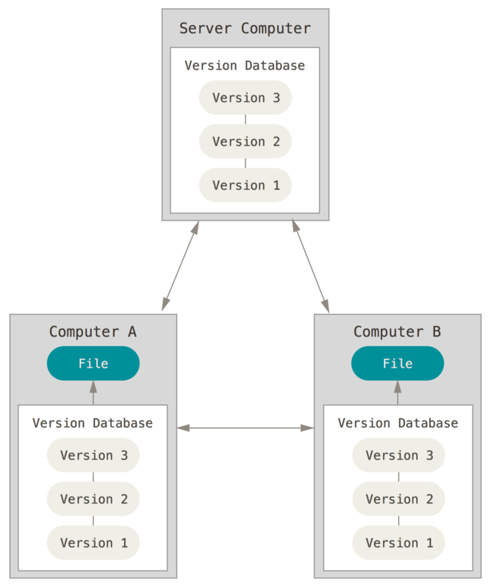
Git
Git is a free and open source distributed version control system.
Version control is a system that records changes to a file or set of files over time so that you can recall specific versions later.
A Git repository stores all versions of the files in your project.
Figure. Distributed Version Control
Notes:
Figure 3, Scott Chacon and Ben Straub, Pro Git, 2nd Ed. https://git-scm.com/book/en/v2.

Slide 3
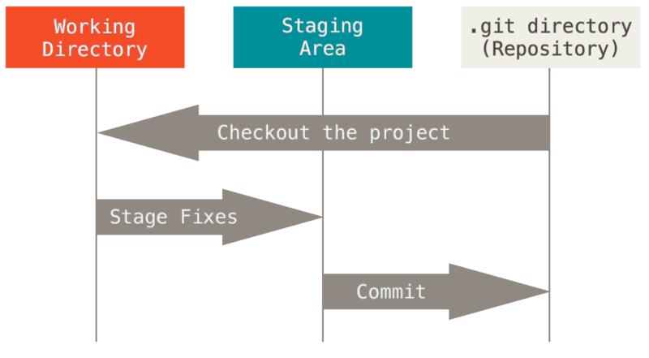
Basic Git Workflow
Modify a file in a working directory.
Add the changes to the staging area.
Do a commit to store the snapshot permanently to your .git directory.
Notes:
Figure 6, Scott Chacon and Ben Straub, Pro Git, 2nd Ed. https://git-scm.com/book/en/v2.

Slide 4
GitHub
GitHub is a hosting service for Git repositories.
GitHub has become a leading software development platform.

Slide 5
HTML
Hypertext Markup Language (HTML) is the standard markup language to create web pages and web applications.
Hypertext is text displayed on a computer display or other electronic devices with references (hyperlinks) to other text that the reader can immediately access.
Web browsers receive HTML documents from a web server or from local storage and render the documents into multimedia web pages.

Slide 6
HTML Documents: Basic Structure
<!DOCTYPE html>
<html>
<head>
<title>My Simple HTML Page</title>
</head>
<body>
<h1>An HTML Page</h1>
</body>
</html>

Slide 7
HTML and CSS
HTML defines the content and structure, including headings, paragraphs, lists and tables. It also defines character formats such as boldface and code examples.
CSS (Cascading Style Sheets) describes how HTML elements are to be displayed.
CSS can be added to HTML elements using the style attribute.
<h1 style="color:blue;">A Blue Heading</h1>

Slide 8
View Deployed Web Pages
Enter a URL (uniform resource locator) into the address bar of your browser.
http://my.liu.edu/~jwang/index.html
protocol domain name path filename
Click on a link that requests another page.

Slide 9
Five Critical Web Development Issues
Users and Usability
Cross-browser Compatibility
User Accessibility
Search Engine Optimization
Responsive Web Design

Slide 10
Five Critical Web Development Issues
Users and Usability
Cross-browser Compatibility
User Accessibility
Search Engine Optimization
Responsive Web Design

Slide 11
Coding Elements and Tags
Most elements start with an opening tag and end with a closing tag.
<h1>Coding Elements and Tags</h1>
<p>Here is a list of the tags:</p>
Some elements have no content or closing tag. They are referred to as empty tags.
<br>
<img src="logo.jpg" alt="Murach Logo">
Nesting of Tags
Correct nesting
<p>Order your copy <i>Today!</i></p>
Incorrect nesting
<p>Order your copy <i>Today!</p></i>

Slide 12
Common Tags
<h?> heading </h?> Heading (h1 for largest to h6 for smallest)
<p> paragraph </p> Paragraph of text
<b> bold </b> Make text between tags bold
<i> italics </i> Make text between tags italic
<a href="url"> link name </a> Create a link to another page or website
<div> … </div> Divide up page content into sections
<img src="filename.jpg"> Show an image
<ul> <li> list </li> </ul> Unordered bullet-point list
<ol><li> list </li></ol> Ordered list
<br> Line break
<span style="color:red"> red </span> Use CSS style to change text color

Slide 13
Coding Attributes
Attributes are coded within the opening tag of an element or within an empty tag.
It is recommended to use double quotes to enclose all attribute values.
<a href="https://liu.edu">
To turn a Boolean attribute on, just code the name of the attribute.
<input type="checkbox" name="mailList" checked>
Attributes id and class are used to identify HTML elements.
<div id="page">
<p class="long paragraph">

Slide 14
Coding Comments
Comments can be used to explain portions of code.
A portion of the code can be commented out.
<!--
This document displays the homepage for the website.
-->
White space is ignored when a HTML document is rendered. It can be used to align and indent the HTML elements.

Slide 15
Customizing Ordered Lists
Changing the numbering style for a list.
The CSS property list-style-type is used with the <ol> tag or <li> tag.
Possible CSS values are "decimal", "lower-alpha", "upper-alpha", "lower-roman", and "upper-roman".
<ol style="list-style-type:lower-alpha;">
Changing the numbering itself.
Use the start attribute of the <ol> tag.
<ol style="list-style-type:lower-alpha;" start="7">
Use the value attribute of the <li> tag.
<li style="list-style-type:lower-alpha;" value="3">

Slide 16
Customizing Unordered Lists
Changing the bullet style for a list.
The CSS property list-style-type is used with the <ul> tag or <li> tag.
Possible CSS values are "disc", "square", and "circle".
<ul style="list-style-type:circle;">
Changing the beginning position.
Use the CSS property list-style-position of the <ol> or <ul> tag.
Possible CSS values are "inside" and "outside".
<ul style="list-style-postion:inside;">

Slide 17
Working with Links
To create a link, you need:
the name of the file or the URL to which you want to link
the text that will serve as the clickable link
Linking local pages
<a href="second.html>Go to the second Web page</a>
Linking to a page on the Web
<a href="http://liu.edu">Long Island University</a>
Linking to Specific Places within Documents
<h2 id="part4">Part Four: Sports</h2>
<a href="#part4">Go to Part 4</a>

